Slide 1
Basics of Mobile Robotics -
Project Presentation

Slide 2
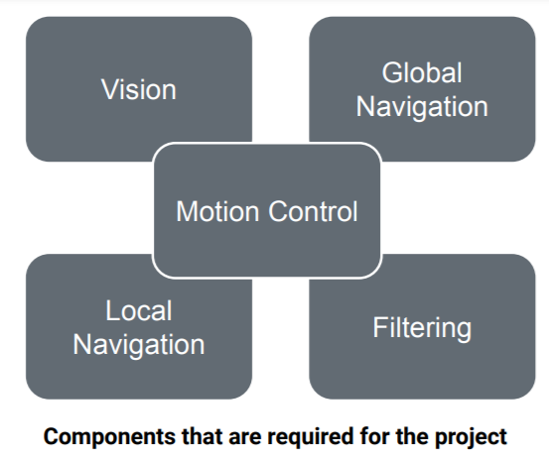
Project Overview

Slide 3
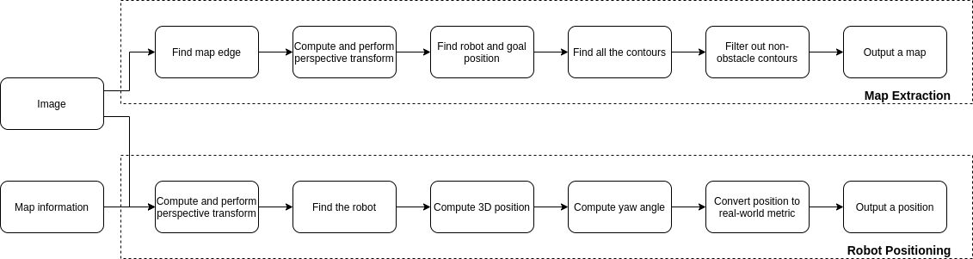
Vision Module
Take an image from the camera
Use OpenCV framework to process
Provide the map
Provide the robot position estimate

Slide 4
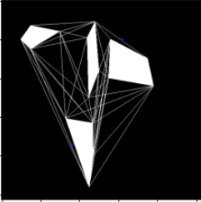
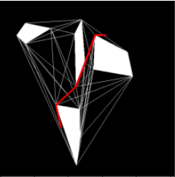
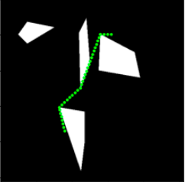
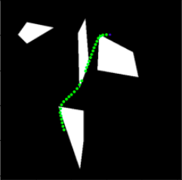
Global Path
Visibility Graph
Dijkstra’s Algorithm
Discretization
Smoothening
Translates the given start node, end node, and set of polygons to a visibility graph and a corresponding adjacency matrix
Computes the shortest path linking the start and end node and returns a list of nodes that would lead from start to end in an optimal way
Subdivides the straight lines joining the selected graph nodes into sets of waypoints separate from one another by a hyperparameter distance h
Extracts portions of the path that correspond to a transition in heading. Converts those portion to a smooth curve and attaches them back to the untouched initial sections

Slide 5
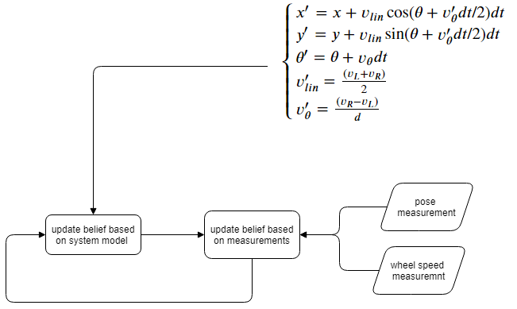
Localisation
goal → combine uncertain measurements with uncertain motion model into accurate belief on the current state
how → Unscented Kalman Filter
(approx) gaussian measurements
non-linear system (differential drive)
less computationally intensive than particle filter

Slide 6
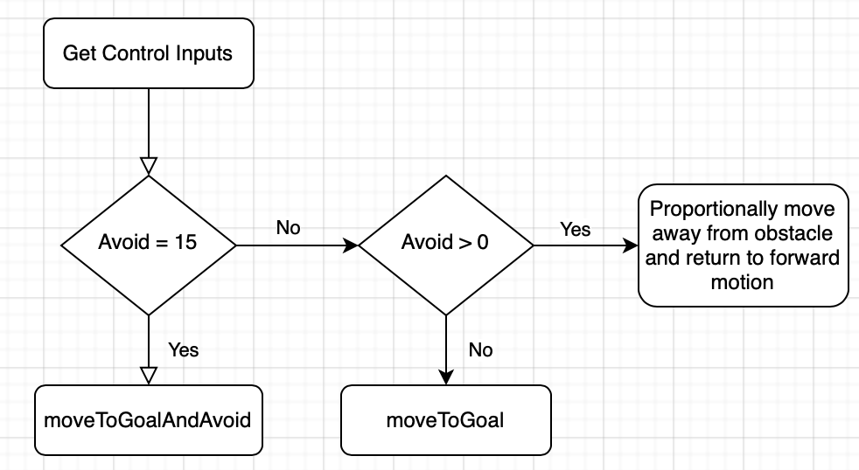
Motion Control
Use current pose, position of next waypoint, and sensor measurements to determine the reference heading angle
Compute heading error
PID Control to obtain motor inputs

Slide 7
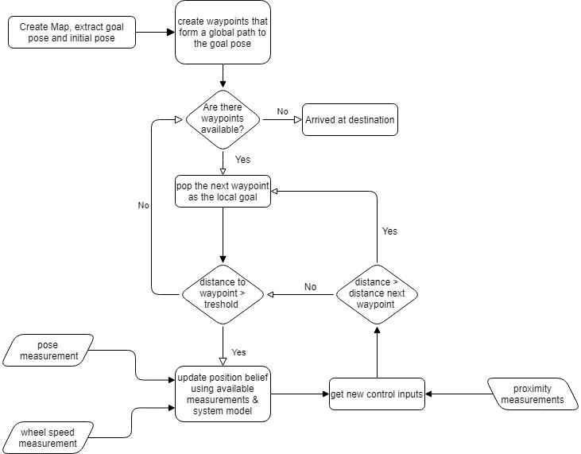
Main control Loop

Slide 8
demo
prerecorded demo
live demo à la carte

